Slide 1
Computer Hardware
Dr. Zahid Halim

Slide 2
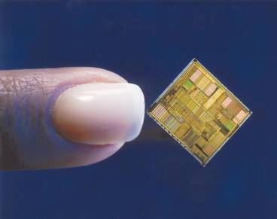
Computer Chips (-1-)
Most electronic components inside a computer are integrated circuits
  Thin slices of silicon crystal packed with microscopic circuit elements
Semiconducting materials are
used to fabricate a chip
Types of chips:
  DIPs; DIMMs; PGAs;
  SEC cartridge
    *The motherboard houses all essential chips and provides connecting circuitry between them

Slide 3
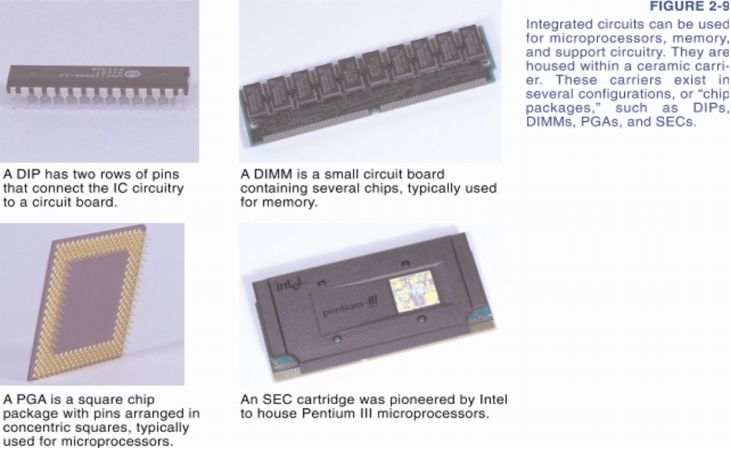
Computer Chips (-2-)
Dual
In-line
Memory
Module
(DIMM)
Dual
In-line
Package
(DIP)
Pin
Grid
Array
(PGA)
Single
Edge
Contact
(SEC)

Slide 4
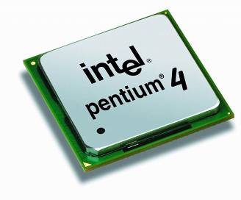
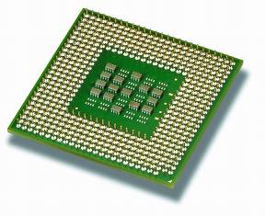
Microprocessor
An integrated circuit designed to process instructions - CPU on a chip
The CPU has two parts
  ALU (arithmetic logic unit)
    Performs arithmetic operations
    Performs logical operations
    Uses registers to hold data being
    processed
  Control Unit
    Directs and coordinates processing

Slide 5
Random Access Memory (RAM)
A temporary holding area for data, application program instructions, and the operating system
  As you type, characters are held in RAM
RAM is primary storage (main memory)
  Measured in megabytes (MB) or gigabytes (GB)
Today’s computers have between 1GB and 9 GB of RAM depending on software you use
  You can purchase additional RAM
  A computer can use disk storage to simulate RAM. This is called virtual memory
    Not as fast as RAM ?

Slide 6
Types of RAM
RAM components vary in speed, technology, and configuration
  SDRAM (Synchronous Dynamic RAM)
  RDRAM (Rambus Dynamic RAM)
  DDR (Double Data Rate)
  DDR2
  DDR3
Speed is measured in nanoseconds.
  1 nanosecond (ns) is 1 billionth of a second
  It can also be expressed in MHz (millions of cycles per second)

Slide 7
Other Types of Memory
Read-Only Memory (ROM)
  Type of memory circuitry that holds the computer’s startup routine
  Permanent and non-volatile
  Only way to change the instructions on a ROM chip is to replace the chip
Additionally, a computer needs a semi-permanent way of keeping boot data
  CMOS (complementary metal oxide semiconductor) memory holds data but requires very little power to retain its contents
    Retains important computer settings after you turn the power off
    Can be run by a battery on the motherboard

Slide 8
Storage Devices
A storage medium is the disk, tape, CD, DVD, paper or other substance that contains data
A storage device is the mechanical apparatus that records and retrieves data from a storage medium
Types of storage devices
  Magnetic Storage
  Optical Storage
  Solid State Storage

Slide 9
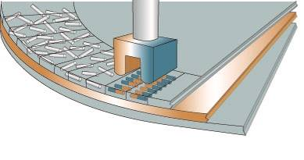
Magnetic Storage
Stores data by magnetizing microscopic particles on the disk or tape surface
Contains a read-write head
  mechanism in the disk drive that reads and writes magnetized particles that represent data
Example
  Hard Disk Drive [HDD]
  Floppy Disk
  Magnetic Tape

Slide 10
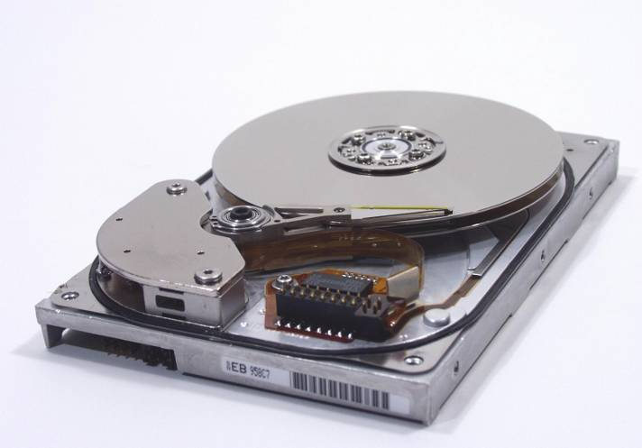
Magnetic Storage : HDD
Working of a hard disk
  Hard disk platter - a flat, rigid disk made of aluminum or glass and coated with magnetic iron oxide particles
  Hard disk - one or more platters and their associated read-write heads
  Capacity up to 250 GB; Preferred type of main storage
Limitations
  Head crash - when a read-write head runs
  into a dust particle or other contaminant
  on the disk
    Head crash damages some data
    on disk
    Triggered by jarring the hard disk
    while in use
    Not limited to hard disks
Platter
R/W Head

Slide 11
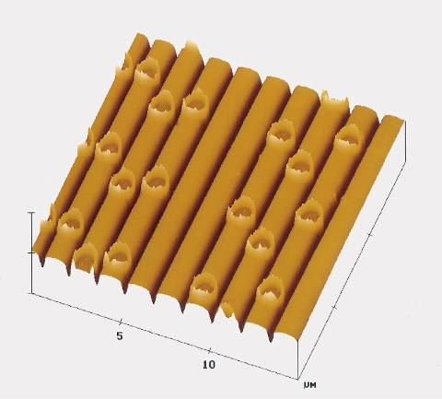
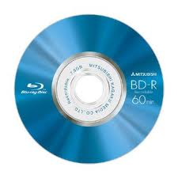
Optical Storage
Stores data as microscopic light spots (lands) and dark spots (pits) on the disk surface
Advantage
  Less susceptible to environmental
  damage than data recorded on
  magnetic media
Example
  CD [Capacity: 700 MB]
  DVD [Capacity: 4.7 GB;
  Double Layered can store up to 8.5 GB]
  Blue-Ray [Capacity: up to 50 GB ]

Slide 12
Optical Storage : CD / DVD
Working of CD / DVD
  Recordable technology uses a laser to change the color in a dye layer sandwiched beneath the clear plastic disk surface
  Rewritable technology uses “phase change” technology to alter a crystal structure on the disk surface
      Much slower than hard disk
      Not a suitable replacement for hard disk yet

Slide 13
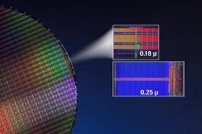
Solid State Storage
Stores data in a non-volatile, erasable, low-power chip
Some solid state storage requires a device called a card reader to transfer data to or from a computer
Advantage
  Provides faster access to data than magnetic or optical storage technology because it includes no moving parts
  Portable
Example
  USB flash drive
  CompactFlash card

Slide 14
Moore’s Law:
An Important Observation (-1-)
Moore's law describes a long-term trend in the history of computing hardware
  Since the invention of the IC in 1958, the number of transistors that can be placed inexpensively on an IC has increased exponentially, doubling approximately every two years
Moore's law is the observation that the number of transistors in a dense integrated circuit doubles approximately every two years

Slide 15
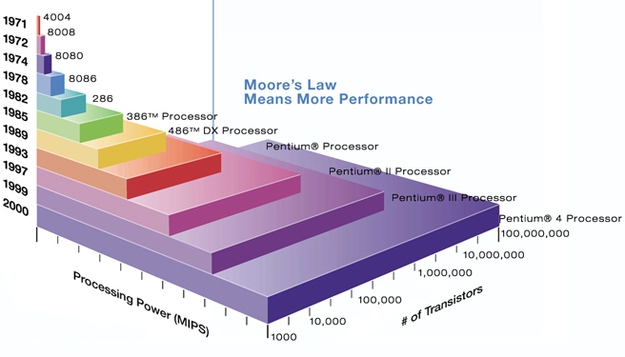
Moore’s Law:
An Important Observation (-2-)

